Slide 1

INTELLIGENT FINANCE ADVISOR

Slide 2
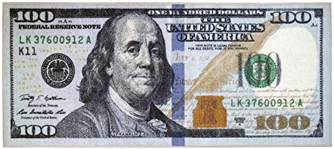
“A penny saved is two pence clear.”
- Benjamin Franklin

Slide 3
CONTENT
Introduction
Problem Statement
Solution
Working Methodology
Technology Stack
Entities and Relationship
Data Flow
Risks
Future Scope
Conclusion

Slide 4

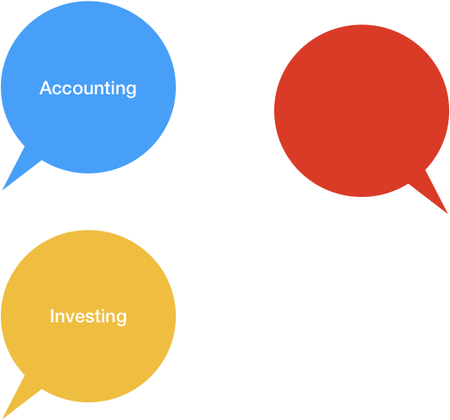
INTRODUCTION
Budgeting
*Data is taken from Statista.com

Slide 5
PROBLEM STATEMENT
Problem Managing Money
Time Consuming
Costly Advisory
Impersonalized Solutions

Slide 6

SOLUTION
Budgeting Application
Native mobile application
AI – powered
Consultant
Returns calculation using ARIMA

Slide 7


WORKING METHODOLOGY
DATABASE OF USERS
ARIMA MODELING
MOBILE APP
COLLECTS DATA
BUDGETS FINANCE
SUGGESTS POSSIBLE INVESTMENTS
REST API FOR FRONTEND CALLS
BACKEND
SERVER
APPLICATION
INTERFACE TO DATABASE
BSE API
SENTIMENTAL
ANALYSIS
TWITTER API

Slide 8







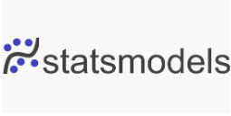



TECHNOLOGY STACK

Slide 9
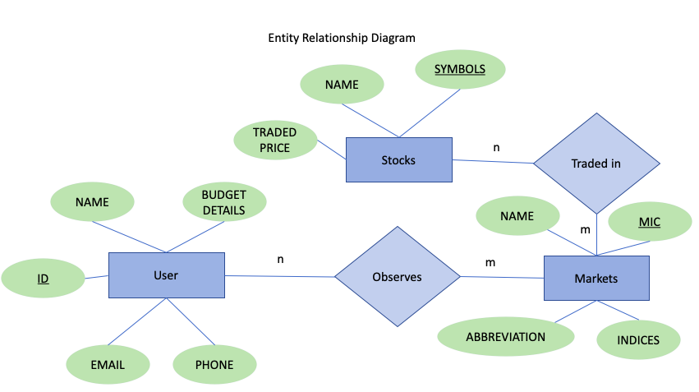
ENTITIES AND RELATIONSHIP

Slide 10
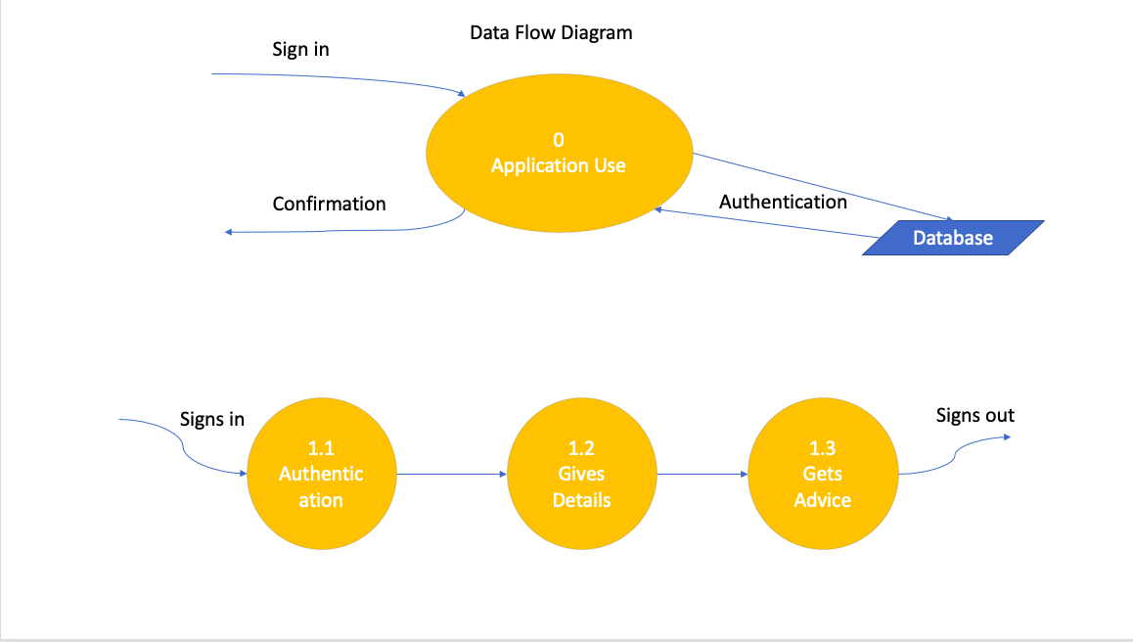
DATA FLOW

Slide 11
RISKS
Predictions will be based on only available dataset.
Markets are very volatile.
Not a browser based application.
Models are true only on ideal conditions.

Slide 12
FUTURE SCOPE
More features for stock prediction can be implemented.
More financial instruments can be implemented.
More accurate way of price prediction can be implemented.
We can use a better set of data for sentimental analysis rather than just tweets.

Slide 13
CONCLUSION
Planning your personal finance gives you the security in this uncertain world.
It is projected to be 6000 billion USD market till 2023.
Micro- finance management for a peer-to-peer economy.

Slide 14


Slide 15


